Slide 1
SALES PRESENTATION

Slide 2
CONTENT
PROJECT OVERVIEW
PROJECT’S STEPS
DATA ANALYSIS DOMAINS
DATA DESCRIPTION
SQL ANALYSIS (QUERIES)
VISUALIZATION (POWER BI)
KEY INSIGHTS
REFERENCES

Slide 3
PROJECT OVERVIEW
OBJECTIVE: The primary objective of this project is to analyze sales data to uncover insights and trends that can help improve business decisions and strategies. By leveraging SQL for data extraction and transformation, and Power BI for data visualization, we aim to provide a comprehensive view of sales performance, customer behavior, and operational efficiency.
TOOLS: For the project, Microsoft Excel, MySQL, & Power BI applications are used.
APPROCH: Employ data analysis, SQL Analysis and Power BI visualization of the data for better understanding.
DATASET: Make use of an extensive dataset that records pertinent attributes.
METHODOLOGY: Investigate different SQL queries to get accurate results and to visualize trends and patterns more clearly.
OUTCOME: Gain practical SQL & Power BI Visualization skills through hands-on experience in Sales Analysis.

Slide 4
PROJECT STEPS
DATA EXTRACTION: Extract the necessary dataset from KAGGLE Repository. Load the dataset in MySQL .Use SQL queries to get a overview of the dataset.
DATA CLEANING: Address any missing, duplicate, data type conversion or inconsistent data. This includes writing SQL scripts to clean the data.
DATA TRANSFORMATION: Transform the raw data into a format suitable for analysis. This includes normalizing data, creating new calculated fields.
SQL QUERIES: Multiple SQL Query for better understanding of data and then take the data for visualizations.
CONNECT TO DATA SOURCES: In Power BI, connect to the SQL database and import the prepared table.
DATA LOADING: Load the data into Power BI, ensuring that it is refreshed regularly if the data is dynamic.
MEASURE CREATIONS: Create DAX measures to calculate key performance indicators (KPIs) and other metrics required for the analysis such as columns that will be required in future calculations.
DESIGN DASHBOARDS: Create interactive dashboards in Power BI. Include visualizations such as charts, graphs, and maps that effectively communicate the data.
INTERPRET DATA: Analyze the visualizations to draw meaningful insights.
GENERATE RECCOMENDATIONS: Based on the insights, generate actionable recommendations for the business.

Slide 5
DATA ANALYSE DOMAINS
SALES ANALYSIS:- Sales analysis using SQL and Power BI is a robust approach for gaining insights into sales performance & customer behavior. SQL is utilized to query the sales database, extracting relevant data such as Unit Price, Quantity & product specifics. This data is then cleaned and aggregated to identify trends, patterns, and anomalies in sales, such as peak sales times, Percentage sales by City & Category. Once the data is prepared, Power BI is employed for visualization. This data is then processed to calculate key performance indicators (KPIs) such as Total Revenue, Average Order value, Total Product Sold, Total Orders.
PRODUCT PERFORMANCE ANALYSIS:- Analyzing the best & worst Products using SQL & Power BI involves a systematic approach to uncovering performance metrics and identifying top-performing and underperforming products. SQL is first employed to query the sales database, retrieving data on individual seller transactions, sales volumes, and Total Revenue. Using Power BI, these KPIs are visualized through interactive dashboards and detailed reports, highlighting the best & worst performers. Visualizations such as Stacked bar charts enable stakeholders to quickly grasp which product excel in terms of revenue and customer satisfaction and which ones lag behind.
CUSTOMER ANALYSIS:- With Power BI, businesses can unlock valuable insights into their customer base, driving data-driven decisions to enhance customer satisfaction and loyalty. Power BI's interactive visualizations can help businesses segment their customers based on purchase history, geographic location, and product preferences, allowing for the development of tailored promotions and loyalty programs. businesses can gain a deeper understanding of their customers, improve customer retention, and drive revenue growth.

Slide 6
DATA DESCRIPTION
The four tables that make up the dataset are listed below:-
Table 1:-“Sales_Orders”
Table 2:-“Customers”
OrderNumber :A unique identifier for each sales order.
OrderDate: The date the sales order was created.
Ship Date: The expected date of shipment for the sales order.
Customer Name Index: A unique identifier for the customers.
Channel: The type of sales order, which can be either "Wholesale", "Distributor", or "Export".
CurrencyCode: The currency in which the sales order was made (e.g., USD, NZD, AUD, EUR, GBP).
Warehouse Code: A unique identifier for the warehouses.
Delivery Region Index: A unique identifier for the cities the product is been sold.
Product Description Index: A unique identifier for the product being sold (e.g., FLR025, AXW291).
Order Quantity: The number of units ordered.
Unit Price: The price of each unit of the product.
Total Unit Cost: The cost of total unit of the products.
Total Revenue: The total value of the sales order.
Customer Index: A numerical identifier for each customer, ranging from 1 to 50. This is the primary key of the table, ensuring each customer has a unique ID.
Customer Names: The official name of the customer. This column includes various naming conventions, including abbreviations (e.g., Ltd, Corp), punctuation (e.g., commas, periods), and capitalization variations.

Slide 7
Table 3:- “Regions”
Table 4:- “Products”
Index: Unique identifier for each suburb.
Suburb: Name of the suburb.
City: Name of the city the suburb belongs to
postcode: Postal code of the suburb
Longitude: Geographic longitude coordinate of the suburb.
Latitude: Geographic latitude coordinate of the suburb.
Full Address: A complete address string including street, suburb, and city.
Index: A unique numerical identifier for each product. It appears to be a sequential integer starting from 1.
Product_Name: The name of each product.

Slide 8
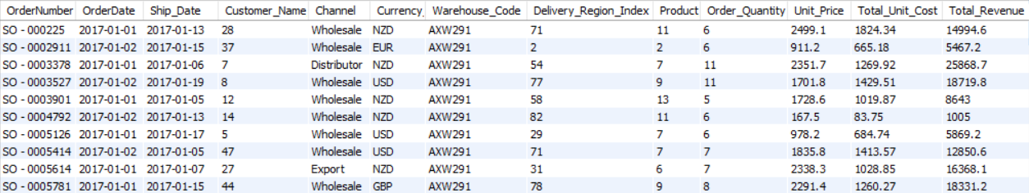
SQL ANALYSIS (QUERIES)
This dataset contain detailed information about sales, including specifics about the customers, quantities, pricing, dates, regions , products & categorization details.
The final results is displayed below after the raw data is fed into SQL tables such as regions, customers, product & sales orders.
Table 1:-“Sales_Orders”

Slide 9
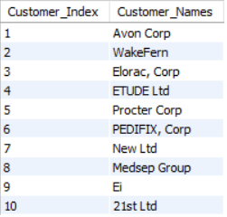
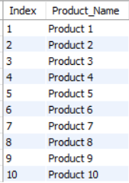
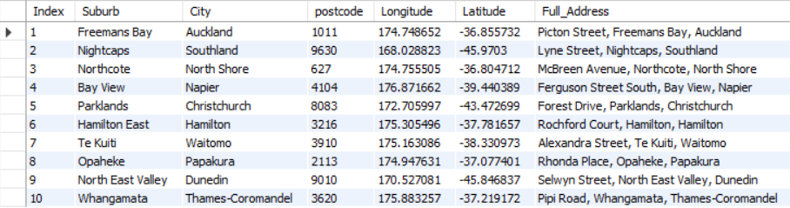
Table 2:-“Customers”
Table 4:- “Products”
Table 3:- “Regions”

Slide 10
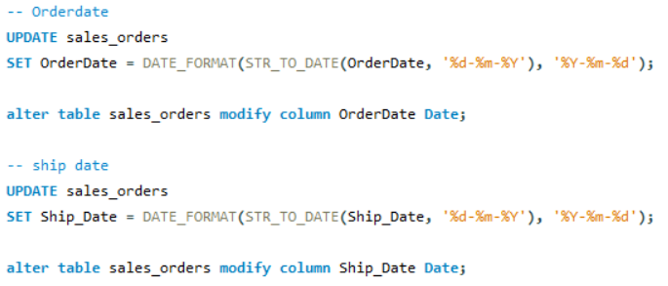
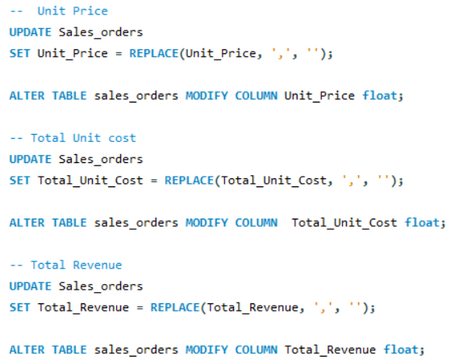
DATA CLEANING & TRANSFORMING
Once the data is entered into SQL, we see that part of the data is distorted. Specifically, the date columns are not formatted correctly, and the data type is incorrect. The SQL query for this is provided below:-
Second, it becomes clear that three columns are dealing with the data type issue. Unit pricing, total revenue, and total unit cost are the three columns. Since the columns contain special characters, we must first figure out how to change the character before changing the data type. The following is the SQL code:-

Slide 11
KEY PERFORMANCE INDICATOR’S
Total Cost: It refers to the complete expense incurred in the production and delivery of goods or services.
Total Orders: The total number of orders placed.
Average Order value: The average amount spent per order, calculated by dividing the total revenue by the total number of orders.
Total Revenue: The sum of the total price of all product orders.
Total Profit: By subtracting the total cost from the total revenue, the profit is computed.
Current Year Sales: To calculate current year sales, sum the revenue from all sales transactions made within the current year.
Previous Year Sales: To calculate previous year sales, sum the total revenue from all sales transactions made during the entire previous fiscal year.
YOY%: Year-over-Year percentage change is calculated as (Current Year’s Value −Previous Year’s Value) /Previous Year’s Value × 100%
Total Products Sold: The Sum Of the quantities of all products sold.
Average Product Per Order: The average number of products sold per order, calculated by dividing the total number of products sold by the total number of orders.

Slide 12
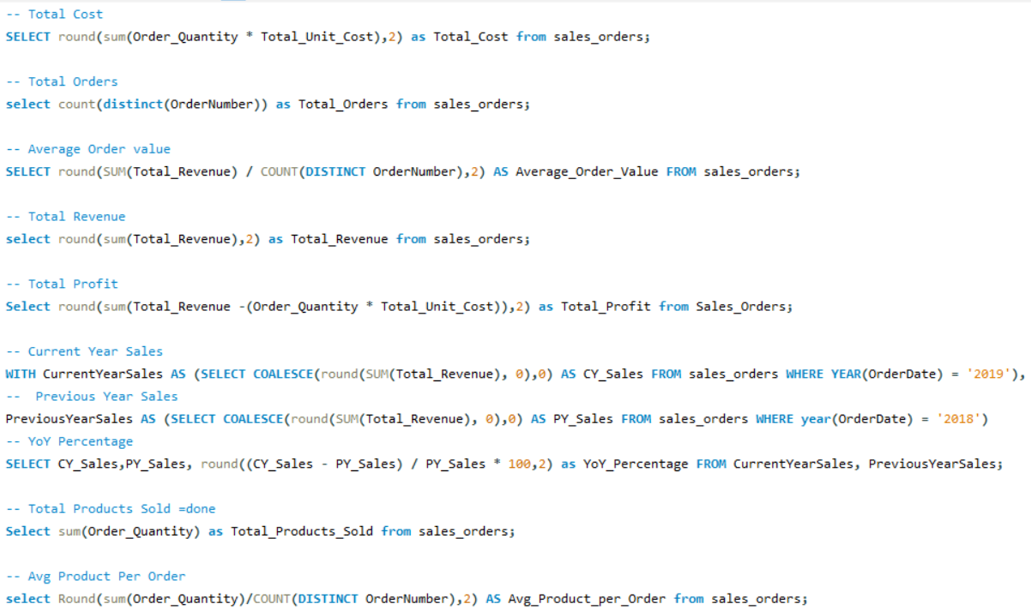








OUTPUTS
OUTPUT
OUTPUTS

Slide 13
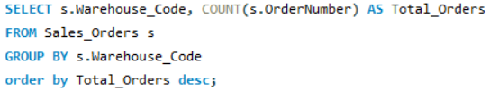
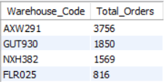
TOTAL ORDERS BY WAREHOUSE CODE
Total orders by Warehouse Code:- Total orders by warehouse code refer to the aggregate number of orders processed and fulfilled by each specific warehouse within a distribution network. This metric is crucial for understanding the operational efficiency, capacity utilization, and performance of individual warehouses. By analyzing the total orders by warehouse code, businesses can identify which warehouses are handling the highest volumes, detect potential bottlenecks or inefficiencies, and make informed decisions about inventory distribution and resource allocation.
OUPUT

Slide 14
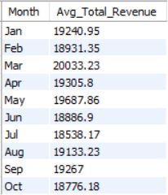
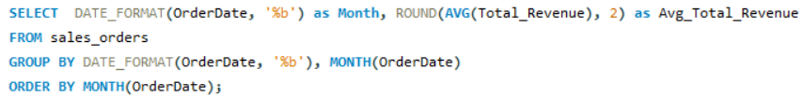
MONTHLY AVERAGE REVENUE
Average Total Revenue By Month:- Average Total Revenue by Month refers to the mean amount of money generated from sales over each month within a specified period, typically a year. This metric helps businesses understand their revenue patterns, identify trends, and make informed decisions.
OUTPUT

Slide 15
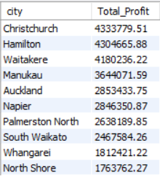
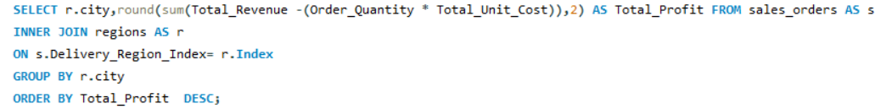
TOTAL PROFIT BY CITY
Total Profit By City:- "Total Profit by City" refers to the aggregate profit generated from business operations within a specific city. Analyzing profit by city allows businesses to identify which locations are most profitable, enabling more informed strategic decisions regarding resource allocation, marketing efforts, and potential expansion or contraction.
OUTPUT

Slide 16
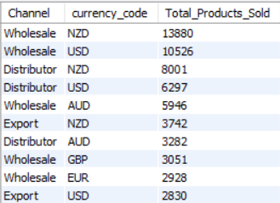
TOTAL PRODUCTS SOLD BY CHANNEL & CURRENCY CODE
The Amount of Products Sold by Currency Code & Channel:- "Total Products Sold by Channel & Currency Code" is a detailed metric that provides insights into the quantity of products sold through different sales channels and specifies the currency used in the transactions. This breakdown helps businesses understand their sales performance across various channels, identify which channels are the most effective, and analyze revenue in the context of different currencies.
OUTPUT

Slide 17
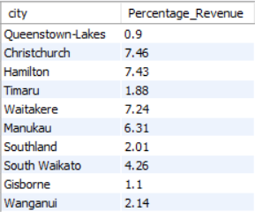
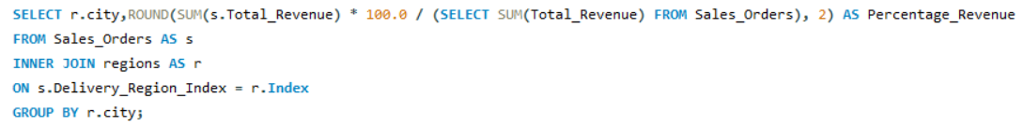
PERCENTAGE REVENUE CALCULATION
% Total Revenue By City:- The percentage of total revenue by city represents the proportion of overall revenue that each city contributes to a business's total income. It provides valuable insights into geographic revenue distribution, highlighting which cities are major revenue drivers versus those contributing less to the overall income. This information helps businesses focus resources on high-performing markets, tailor marketing strategies to local preferences, and optimize operational efficiencies based on regional performance trends.
OUTPUT

Slide 18
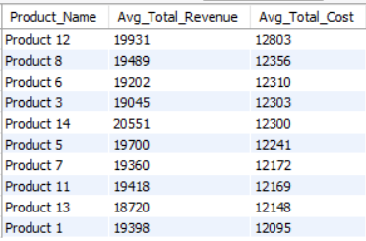
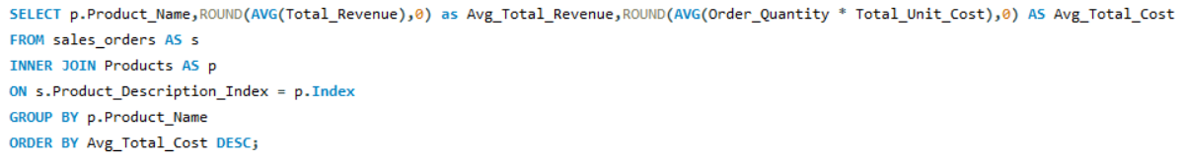
AVERAGE COST & REVENUE BY PRODUCT NAME
Avg Cost & Avg Revenue by Product Name:- Analyzing average cost and revenue by product name involves calculating the average financial metrics associated with each specific product or service offered by a business. Average Cost helps businesses understand the per-unit cost efficiency of each product line, aiding in pricing strategies and profitability assessments. On the other hand, average revenue per product name reflects the average income generated from selling each unit of a specific product. By analyzing these averages, businesses can pinpoint strengths and weaknesses across their product portfolio, guiding strategic decisions aimed at enhancing profitability and market competitiveness.
OUTPUT

Slide 19
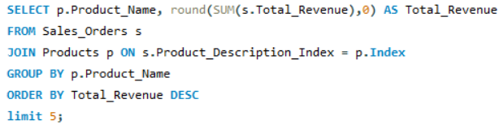
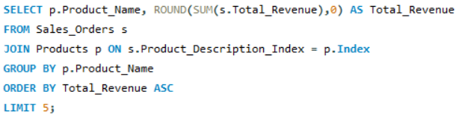
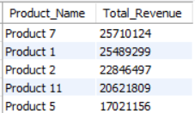
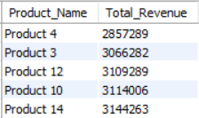
BEST/WORST PRODUCTS BY TOTAL REVENUE
Top 5 Products by Revenue: This SQL code shows the Top 5 best products based on Total Revenue. This numbers will help us identify the most popular products options.
Bottom 5 Products by Revenue: This SQL code shows the Bottom 5 products based on Total Revenue. This numbers will help us to identify the not so popular products options.
OUTPUTS

Slide 20
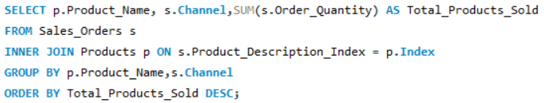
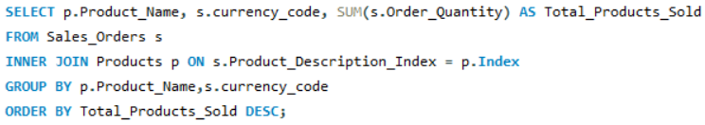
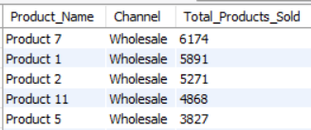
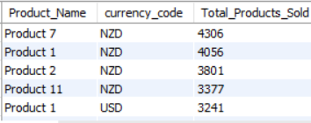
PRODUCTS PERFORMANCE
Products Performance By Channel:- Product performance by channel refers to the assessment of how well a product is selling across different distribution channels it also shows the Total products sold through each channel. This analysis helps businesses optimize their marketing strategies, allocate resources efficiently, and tailor their product offerings to better meet consumer demand across various channels, ultimately enhancing overall profitability and market competitiveness.
Products Performance By Currency Code:- Product performance by currency code assesses how well a particular product or range of products is performing in different currencies. It then shows the products sold through each currencies. This analysis helps businesses identify strong-performing products in specific currencies, optimize pricing strategies based on currency fluctuations, and make informed decisions regarding inventory management, marketing campaigns, and expansion opportunities in targeted geographical areas.
OUTPUTS

Slide 21
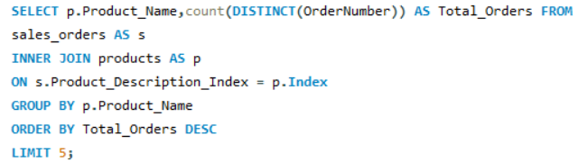
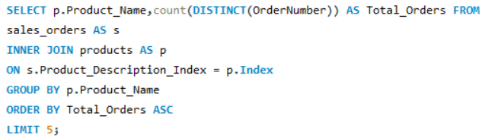
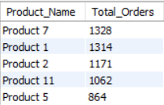
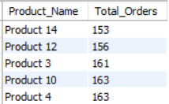
BEST/WORST PRODUCTS BY TOTAL ORDERS
Top 5 Products by Orders: This SQL code shows the Top 5 best products based on Total Orders. This numbers will help us identify the most popular products options.
Bottom 5 Products by Orders: This SQL code shows the Bottom 5 products based on Total Orders. This numbers will help us to identify the not so popular products options.
OUTPUTS

Slide 22
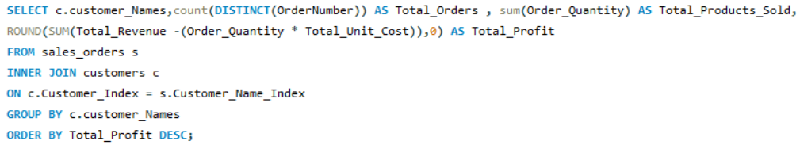
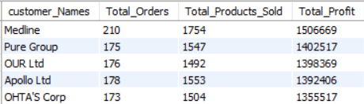
CUSTOMER BEHAVIOUR
Customer Purchase Pattern:- Understanding customer behavior involves analyzing factors such as demographics, psychographics, buying patterns, and preferences to predict and influence future purchasing decisions. With the help of this SQL query, we can determine which customers buy more products, how much is shipped to them, and how much each client contributes to our bottom line.
OUTPUT

Slide 23
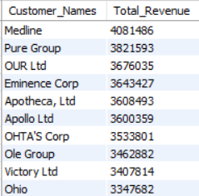
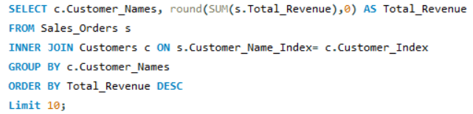
TOP CUSTOMERS BY REVENUE
Top 10 Customers By Total Revenue:- It refers to a business strategy or analysis that identifies and ranks the ten customers who contribute the highest total revenue to a company over a specified period, typically a fiscal year. This analysis helps businesses understand which customers are the most significant in terms of financial impact, allowing them to prioritize resources such as marketing efforts, customer service enhancements, and personalized engagement strategies towards these key accounts. By focusing on the top revenue-generating customers, companies can strengthen relationships, improve retention rates, and potentially uncover opportunities for further growth and profitability. This approach also aids in strategic decision-making, such as pricing adjustments or product development tailored to meet the needs and preferences of these valuable customers.
OUTPUT

Slide 24
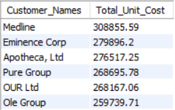
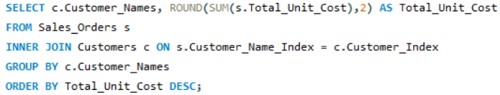
UNIT COST BY CUSTOMERS
Total unit cost by customers:- It refers to the combined expenses incurred by a business to produce and deliver a single unit of product, as perceived and influenced by the customer. Understanding total unit cost is crucial for businesses as it directly impacts pricing strategies and profitability. By analyzing these costs from the customer's perspective, companies can ensure competitive pricing while maintaining quality and profitability standards, ultimately enhancing customer satisfaction and optimizing financial performance.
OUTPUT

Slide 25
MySQL SERVER
CONNECT
POWER BI
Connecting SQL Server to Power Bi is an essential step in leveraging the powerful data visualization capabilities of Power BI to analyze sales data stored in MySQL server. This connection allows for the seamless integration of robust data management with interactive reporting, provide valuable insights into Sales trend, product performance and customer’s product preferences.
Benefits:
Real-time Data Analysis: With DirectQuery, Power BI can query data directly from SQL Server, providing up-to-date insights without the need for frequent data imports.
Comprehensive Reporting: By combining queries and views from SQL Server, Power BI enables the creation of detailed and comprehensive reports that cover various aspects of sales.
Interactive Dashboards: Power BI’s interactive features allow users to filter data dynamically, drill down into details, and uncover hidden trends in sales data.
Improved Decision-Making: The insights derived from Power BI reports can inform strategic decisions such as inventory management, marketing campaigns, & customer engagement strategies.
In summary, the integration of SQL Server with Power BI for sales analysis empowers businesses to transform raw sales data into actionable insights, driving better decision-making and enhancing overall business performance.

Slide 26

DAX FORMULA’S
We can now construct new measures & columns using the DAX formulas after connecting SQL to Power Bi. Data Analysis Expressions (DAX) is a formula expression language used in Analysis Services, Power BI, and Power Pivot in Excel. DAX formulas include functions, operators, and values to perform advanced calculations and queries on data in related tables and columns in tabular data models.
In accordance with the demand, we have computed new measures and columns. Below are the dax formulas for the new measures & columns:-
NEW MEASURES
1. Average Order Value =
2. Total Orders =
3. Total Products sold =

Slide 27



4. Avg Products Per Order =
5. SumSales =
6. CY Sales =
7. PY Sales =
8. YOY% =
NEW COLUMNS
1. Total Cost =
2. Total Profit =
Now that all the metrics and columns have been created, we can move on with creating interactive dashboards. You can view the reports in the next three slides.

Slide 28
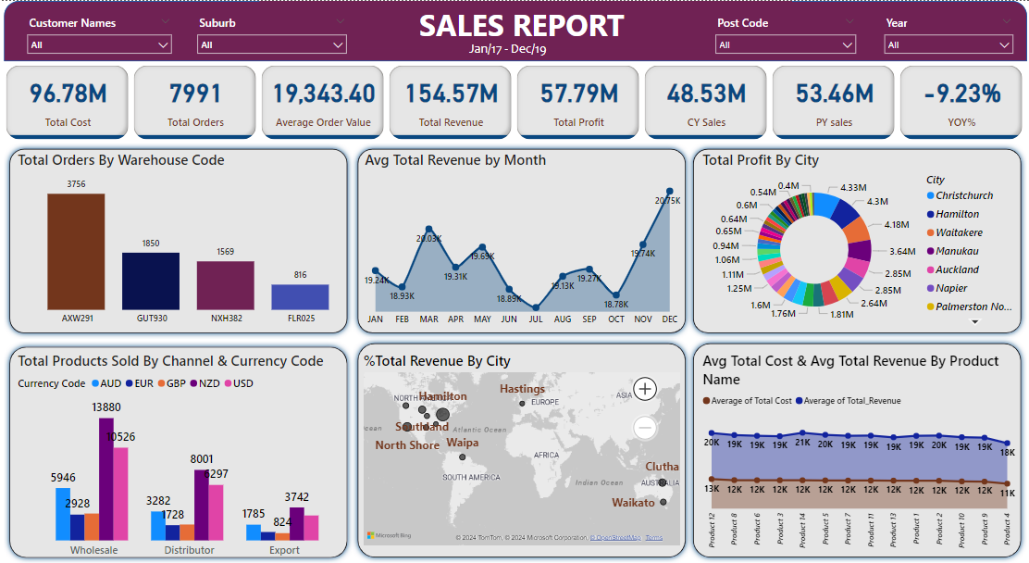
REPORT – 1: SALES REPORT

Slide 29
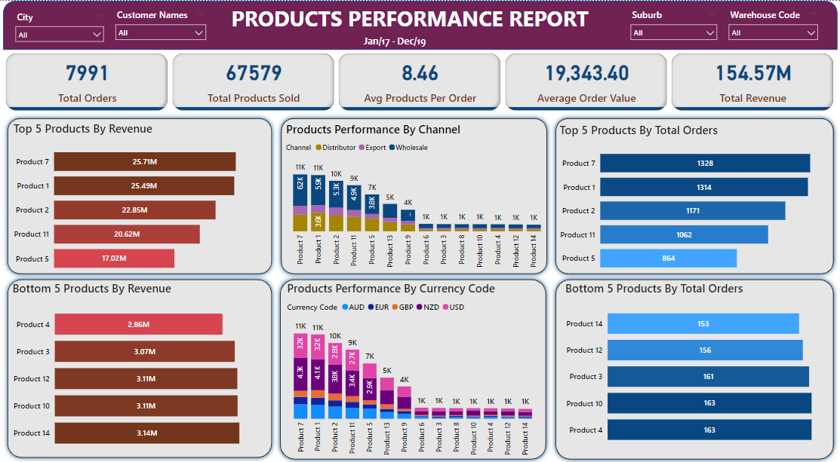
REPORT – 2: PRODUCT PERFORMANCE REPORT

Slide 30
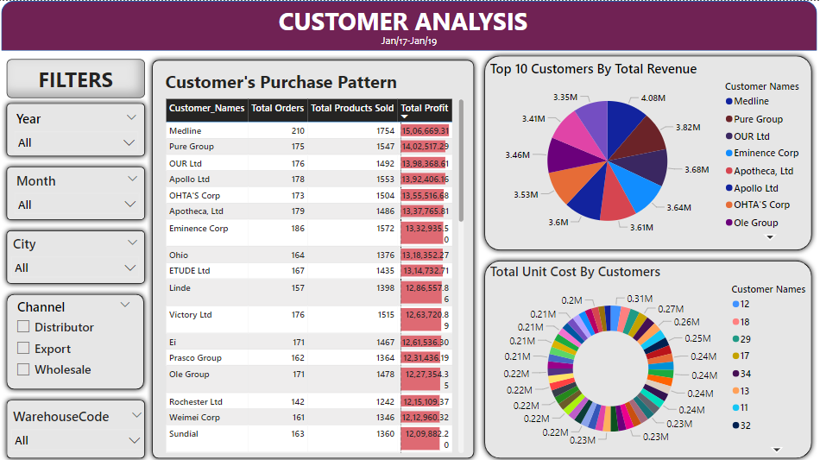
REPORT – 3: CUSTOMER ANALYSIS

Slide 31
KEY INSIGHTS
FROM REPORT 1: SALES REPORT
1. KPI’S REQUIREMENT:
KEY PERFORMANCE INDICATOR:-
Total Cost : The Expenses incurred in the production & delivery of goods are 96.78M.
Total Orders: The total number of orders placed is 7,991.
Average Order value: The average amount spent per order is 19,343.40.
Total Revenue: The sum of the total price of all products orders is 154.57M.
Total Profit: The actual profit is 57.79M.
CY Sales: The Sum of the revenue from all sales transactions made within 2019 is 48.53M.
PY Sales: The Sum of the revenue from all sales transactions made within 2018 is 53.46M.
YOY%: The difference between current year and previous year is -9.23%.

Slide 32
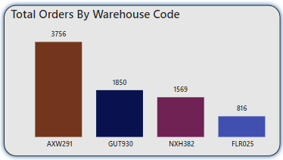
2. STACKED COLUMN CHART:
TOTAL ORDERS BY WAREHOUSE CODE
The purpose of this stacked column chart is to display total orders by warehouse code. It is evident from the chart that AXW291, with 3,756 orders, is the Warehouse that proceed & fulfill the highest orders, followed by GUT930(with 1850 orders) ,NXH382(with 1569 orders) . The FLR025(with 816 orders) is the warehouse that fulfill the least orders to the customers.

Slide 33
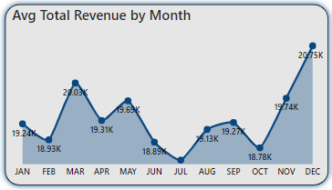
3. AREA CHART: AVERAGE TOTAL REVENUE BY MONTH
This Area Chart was created to display the Average Total revenue for each month. The graph makes it evident that the top three months of the year are December with average revenue of 20.75K, March with 20.03k average Revenue & November with 19.74k. February & October saw the least average revenue, at 18.93K & 18.78K respectively. This indicates that the majority of revenue is generated in December and then March.

Slide 34
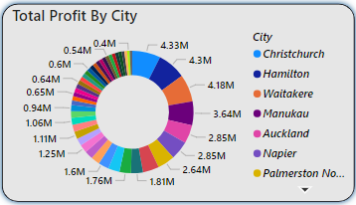
4. DONUT CHART:
TOTAL PROFIT BY CITY
Donut charts is made to display how profit is made among different cities. The graphs clearly show how profits are made throughout the cities; at 4.33 million, Christchurch is the city that generates the most profits. Waitakere and Hamilton are in third and second place, respectively, with 4.18 and 4.3 million. In this manner, we can concentrate our efforts on cities that generate lower profits.

Slide 35
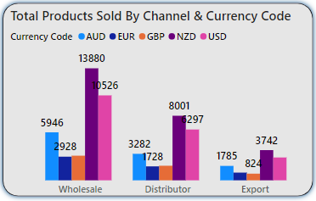
5. CLUSTERED COLUMN CHART:TOTAL PRODUCTS SOLD BY CHANNEL & CURRENCY CODE
The products sold by channel and currency are shown in the clustered column chart. It is evident that the sold goods is bifurcated first by channel and subsequently by currency code. With 13,880 products, the product in the wholesale channel is sold in New Zealand dollars. Then, 10,526 products were sold using USD. The final two currencies are EUR and AUD. Additionally, the distributor channel sold the most number of products in NZD, followed by USD, with 8001 and 6297 products respectively. The final export channel trades primarily in NZD and USD rather than AUD and EUR. This Shows that the business mainly deals in NZD and USD.

Slide 36
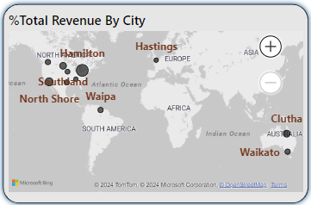
6. MAP: % TOTAL REVENUE BY CITY
This map is designed to show the location that helps the business generate the most revenue, expressed as a percentage. The city that generates the highest revenue for the business is Queenstown-Lakes, which brings in 9% of the total revenue. Christchurch and Hamilton come in second & third, with 7.46% & 7.43% of the revenue, respectively. Then rest of the cities you can see in the map. This helps the decision maker to focus on location that are less contributing in the business.

Slide 37
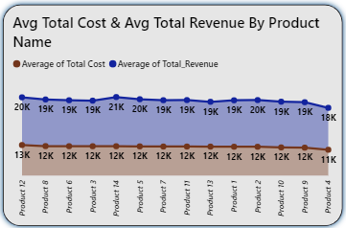
7. STACKED AREA CHART:
AVG TOTAL COST & AVG TOTAL REVENUE
BY PRODUCT NAME
Analyzing average cost and revenue by product name involves calculating the average financial metrics associated with each specific product or service offered by a business. It shows that every products Average revenue is more than the Average total cost of each product. Product 12 has the most Average cost (13K) and generates the highest revenue (20K) . It shows every products is performs well according to there cost and revenue . Product 2 is the one with a high Average revenue but the cost is less than Product 12 .

Slide 38

FROM REPORT 2: PRODUCT PERFORMANCE REPORT
1. KPI’S REQUIREMENT:
KEY PERFORMANCE INDICATOR:-
Total Products sold : The total product sold during the business are 67,579 units.
Avg Products Per Order: The average number of products sold per order is 8.46 units.

Slide 39
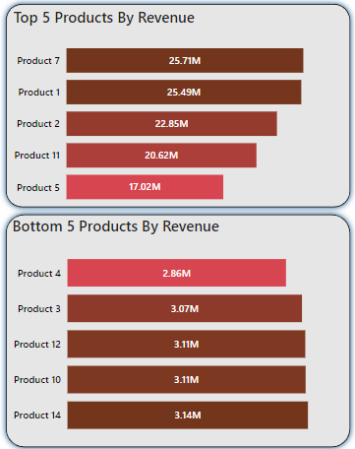
2 & 3 STACKED BAR CHART: TOP & BOTTOM PRODUCTS BY REVENUE
The top five products in terms of revenue are displayed in the first visual expression. With 25.71M, Product 7 bring in the most money. Product 1(25.49M), Product 2 (22.85M), & Product 5(17.02M) products are next in line.
In the second visual expression, the lowest five products in terms of revenue are shown. Product 4 makes the least money, with 2.86M. The next in line, in minimum revenue, are the Product 3 (3.07M), Product 12 (3.11M), Product 10 (3.11M), & Product 14 (3.14M).

Slide 40
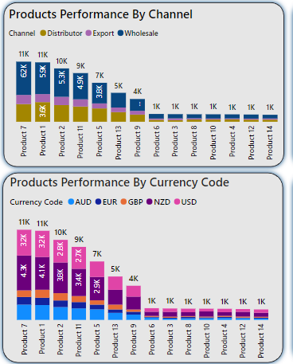
4 & 5 STACKED COLUMN CHART: PRODUCT PERFORMANCE BY CHANNEL & CURRENCY CODE
The first visual representation shows the product performance by channel. Every product show the total products sold according to channel . Product 7 (11K) is the most sold product. Then we can see that channel wholesale sells most product 7 with 6.2K. Then export does the most sales. It goes for the rest of the products in the graph.
In the second visual expression, it represents the product performance by currency code . Every product show the total products sold according to Currency Code . Product 7 (11K) is the most sold product. Then we can see that currency code NZD sells most product 7 with 4.3K . Then USD does the most sales. It goes for the rest of the products in the graph.

Slide 41
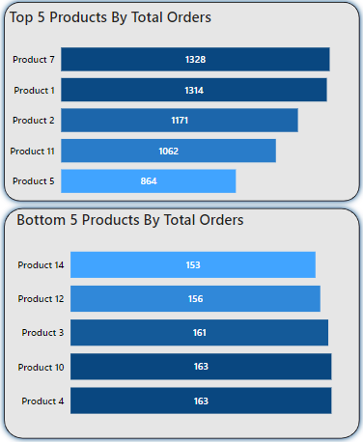
6 & 7 STACKED BAR CHART: TOP & BOTTOM PRODUCTS BY ORDERS
The top five products in terms of orders placed are displayed in the first visual expression. With 1328, Product 7 is the product that is ordered mostly. Product 1(1314), Product 2 (1171),Product 11(1062) & Product 5(864) products are next in line in terms of Orders.
In the second visual expression, the lowest five products in terms of order placed are shown. Product 14 makes the least orders, with 153. The next in line, in minimum orders, are the Product 12 (156), Product 3 (161), Product 10 (163), & Product 4 (163).

Slide 42
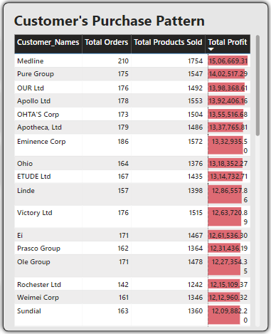
FROM REPORT 3:CUSTOMER ANALYSIS
1. TABLE: CUSTOMER’S PURCHASE PATTERN
This table makes it easy to monitor how customers behave when making purchases. This provides comprehensive customer information, allowing us to view the products they have ordered and the profit the business has made from each individual consumer. We can clearly see the top 3 customers according to the table are Medline , Pure Group and OUR LTD. Medline ordered 210 times , they get 1754 products for these orders and the money that our business makes is 1.5M. This same goes for the rest customers.

Slide 43
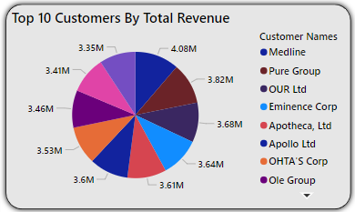
2. PIE CHART:TOP 10 CUSTOMERS BY TOTAL REVENUE
We can examine the top 10 customers by total revenue in this pie chart. It displays the type of clients who generate the most income for the company. We can clearly see the top 3 customers according to the table are Medline , Pure Group and OUR LTD. The revenue that we generated from Medline is 4.08M and for the rest it is 3.82M and 3.68M. The rest of the chart shows other customers that help to make the money for the business or company.

Slide 44

3. DONUT CHART: TOTAL UNIT COST BY CUSTOMERS
It refers to the combined expenses incurred by a business to produce and deliver a single unit of product, as perceived and influenced by the customer.
As we saw before Medline is the Top customer for the business here also the most Total unit cost spend is on Medline of 0.31M. We can see the rest of the 44 customers . This helps us to understand the value of the customers.

Slide 45

REFERENCES
Data Source:
yesrahulkr. “Sales Analysis Report on Power BI.” Kaggle, 2020. Available at: Kaggle Sales Analysis Report on Power BI
Data Access Method:
The dataset was directly downloaded using the Kaggle with the following link:
https://www.kaggle.com/datasets/yesrahulkr/sales-analysis-report-on-power-bi
The dataset can also be accessed and downloaded using the Kaggle API with the following command:
kaggle datasets download -d yesrahulkr/sales-analysis-report-on-power-bi
This commands allows for easy programmatic access and integration of the dataset into data analysis workflows.

Slide 46


